Slide 1


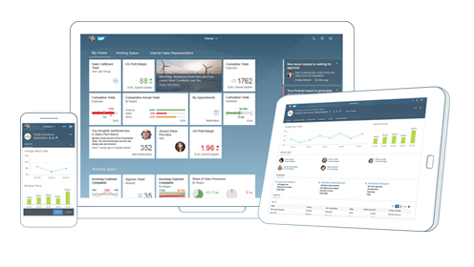
Introduction To UI5:
SAP UI5 is a framework to develop responsive web applications
Framework – collection of libraries
Library - Collection of class
Class – collection of attributes, events, methods and functions
SAPUI5 (SAP user interface for HTML5) is a collection of libraries that you can use to build desktop and mobile applications that run in a browser.

Slide 2

What is HTML ?
HTML stands for Hyper Text Markup Language. Which is used to create static web pages.
HTML is not a programming language, it is a markup. E.g. if we create a button using HTML we cannot write logic of that button using HTML.
HTML describes the structure of a Web page.
HTML consists of a series of elements.
HTML elements tell the browser how to display the content.

Slide 3

What is JavaScript?
JavaScript is browser’s programming language.
All the browser’s directly understand JS. It has nothing to do with Java.
Each browser can understand JS code and execute directly. However the engines which execute JS in each browser is different.
JavaScript is a lightweight language.
Why we use JS?
We can show output to the user
Validate the data
Send server requests
Dynamically change and add Element on the screen…. Many more

Slide 4

Steps to Create a Demo App:-
Create a folder in VS code (DemoApp) and then,
Initialize a node project (npm init) .
Mentioning it is a UI5 type project so we run the command called ui5 init.
Create a webapp folder inside the parent folder(DemoApp) name webapp.
Add a manifest.json file inside webapp folder which talks about our project properties (sap.app, sap.ui, sap.ui5).
Create a HTML file inside the webapp folder (index.html)
Create the HTML head and body inside the <html> tag.
Create a button inside the body using the <button> tag which has a onclick property having a function named onClick(),
Create the Script tag inside the head , here we write our functionability for our button using javascript language.
Create a function with the same name given inside the button’s onclick property.
function onClick() {
alert("Hello Guys");
}

Slide 5
Title
Content

